Slide 1
Futuro COP/DEV e Geopolitica
Ana Fernandes

Slide 2
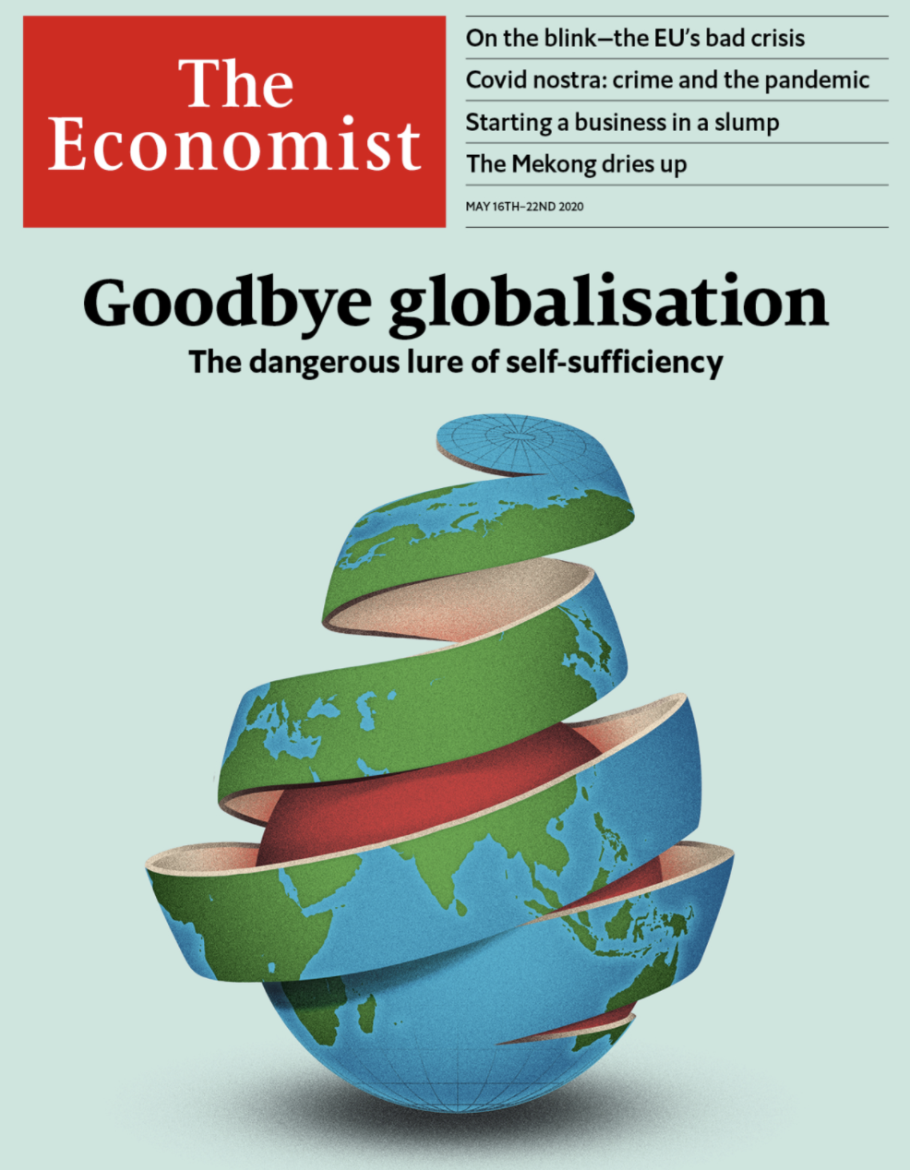
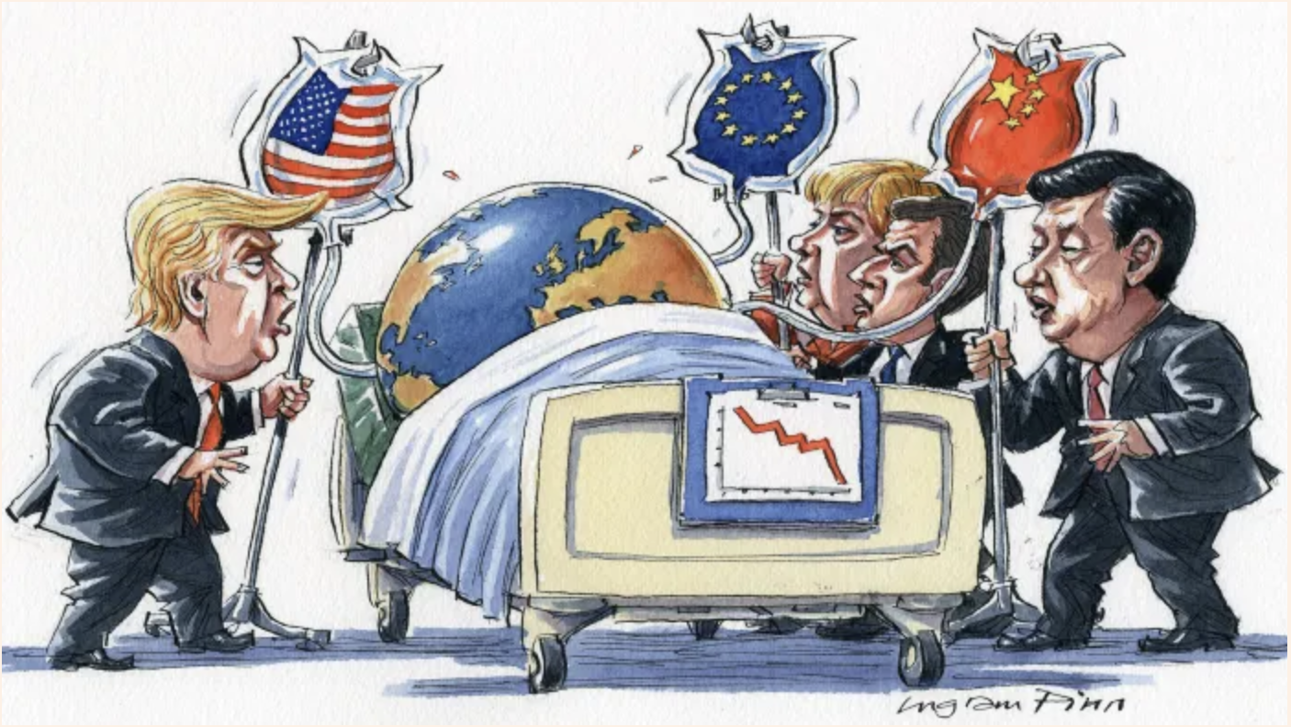
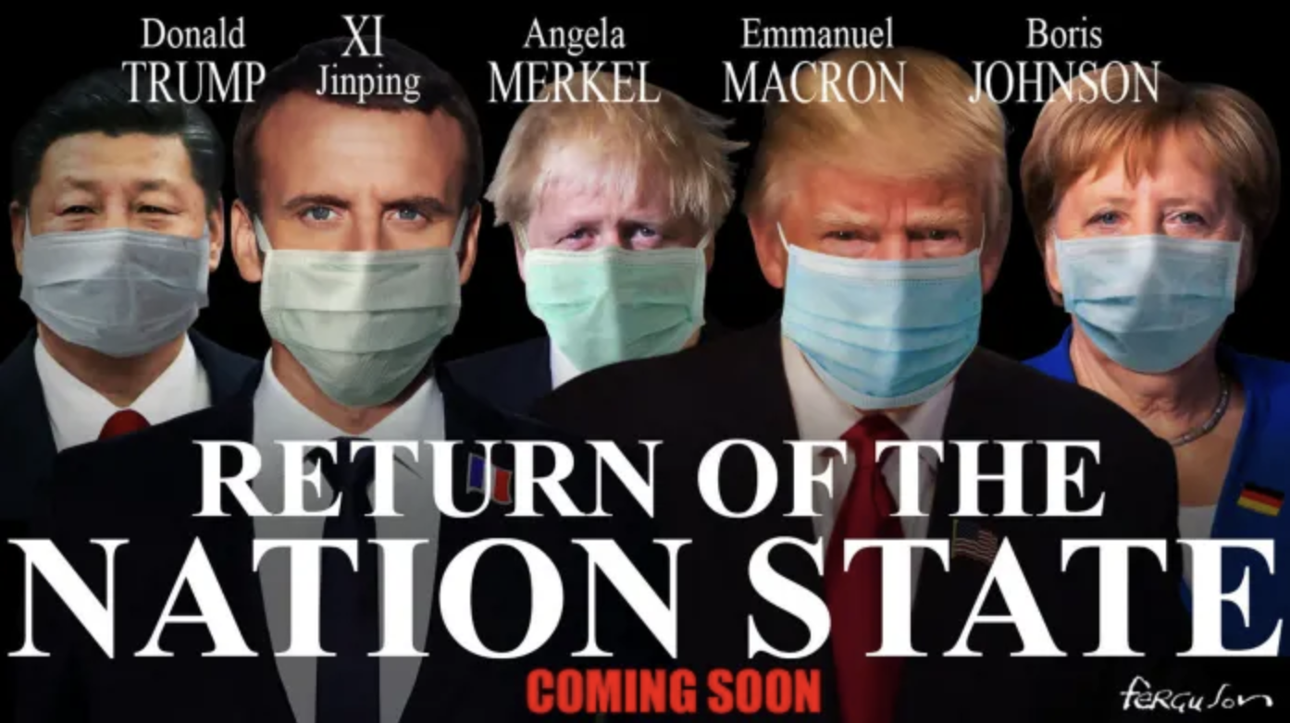
Anti-globalisation and nationalism

Slide 3
Strategic Foresight at the OECD
Mission: strengthen capacity to anticipate and prepare for emerging policy issues
    across the OECD
    in national governments, and
    in global policy dialogue
Notes:
The OECD has long been a champion of the use of strategic foresight to inform and improve public policy. Pioneering futures work by the OECD in the 1960s and 1970s included significant efforts to explore alternative scenarios for the economy and environment, societal change, development, and international collaboration. This work laid the foundation for the creation of the International Futures Programme in 1990, which aimed to help decision makers in government and industry assess the economic, social and technological trends shaping the future. This involved conducting influential Global Scenarios 2035: Exploring implications for the future of global collaboration and the OECD  9 GLOBAL SCENARIOS 2035 © OECD 2021 foresight studies in areas of common global concern, and led to the establishment of important new areas of work for the Organisation. Over the past decade, the OECD has expanded foresight practices across many areas of its mandate. Significant foresight and futures-focused initiatives have supported the work of many directorates and committees, including in development and development co-operation, education, employment, environment, migration, cities and rural areas, policy innovation, science and technology, tax, tourism, transport and many others. Further embedding foresight practices such as horizon-scanning and scenarios development can benefit all areas of policy analysis and advice. This will be particularly important to ensure the viability of COVID-19 recovery plans and investments.

Slide 4
Why foresight?
Identify new opportunities and challenges
‘Future-proofing’
Spur innovative thinking on solutions
Notes:
How do organisations use foresight?
Foresight can support organisations in designing more resilient, agile and adaptive strategies through:
Better anticipation: identifying changes that could emerge in the future and new opportunities and challenges for policy-making
Future-proofing: using a range of plausible future scenarios to stress-test existing strategies
Policy innovation: developing new ideas and identifying policies that are robust across a range of futures

Slide 5
Why foresight at the DAC? Development Cooperation
Identify new opportunities and challenges
‘Future-proofing’ creating resilience and support institutions and policy making adapting, innovating and reforming
Spur innovative policies, programs, partnerships
Use foresight to inform policy and political decisions
aligned with the main priorities/ interests of the DAC members so that the analysis can be used and support ongoing strategic reflections
Notes:
How do organisations use foresight?
Foresight can support organisations in designing more resilient, agile and adaptive strategies through:
Better anticipation: identifying changes that could emerge in the future and new opportunities and challenges for policy-making
Future-proofing: using a range of plausible future scenarios to stress-test existing strategies
Policy innovation: developing new ideas and identifying policies that are robust across a range of futures
ONE way to inform good decisions
Questioning what we expect
Testing if hopes are realistic
Organised and systematic process to engage with uncertainty
Collective intelligence, knowledge creation process that uses the future(s)
DAC Program of Work and Budget - PWB 2021/2022
2.14. Foresight Community of Practice: Policy Papers; policy brief on emerging trends, including cascading impacts from Covid-19, DAC friends of Foresight Community meetings to support members in advancing foresight and strategic thinking for effective development cooperation.
Expected Outcome: Development co-operation and sharing of systems and practices leading to more effective, resilient approaches, rooted in anticipatory policymaking and subsequent actions, and informed by futures thinking and strategic foresight, including the use of such tools as scenario planning, horizon scanning of emerging trends, risk analysis and optimising development opportunities.
Intermediate Outputs: Policy Papers; policy brief on emerging trends, including cascading impacts from Covid-19, DAC friends of Foresight Community meetings to support members in advancing foresight and strategic thinking for effective development co-operation.
DAC PWB Covid-19 Package
Expected Outcome: DAC members are better equipped to support holistic responses and resilience of developing countries against global pandemics.
It is also included in the DAC PWB Covid 19 Package - Promoting, sharing and coordinating foresight data and analysis on the Covid-19 crisis impact across development cooperation providers’ foresight work to promote preventative and resilient frameworks.
Category: c. Peer Learning, Evaluations and Dialogue
Partners: OECD Foresight Office, and DAC Development Agency Foresight offices
DAC platform: Friends of Foresight

Slide 6
Why foresight now?
In a time of rapid change and rising uncertainty, responsible policy-making requires considering and preparing for the unexpected
Notes:
Foresight for what?
To ensure that development co-operation policies remain relevant in the face of current megatrends and to foster innovation, we will need to scan the horizon, identify and analyse new trends and game changers and will apply foresight approaches. This will facilitate the necessary steps towards imagining alternative and plausible futures so as to build preparedness in and through development co-operation work. Foresight can help development co-operation providers future-proof their decision-making.
FOR Unit supports DCD and DAC advancing foresight and futures thinking so we can better prepare to respond to crisis and foster innovative solutions to development cooperation:
DAC Friends of Foresight (includes DAC representatives, experts from development finance institutions, academia, think thanks, civil society and foundation – a community of 70 members co-chaired by the US and Swisszertland).
DCD Focal points on Foresight (from all the DCD Divisions)

Slide 7


Slide 8
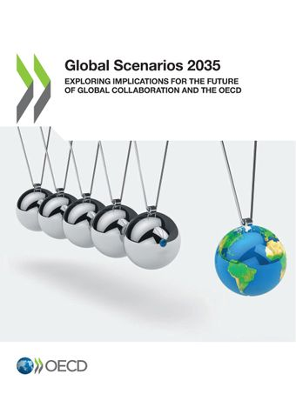
Global Scenarios 2035
Exploring Implications for the Future of Global Collaboration and the OECD
Multitrack World, Virtual Worlds, and Vulnerable World
Notes:
This report explores three scenarios – Multitrack World, Virtual Worlds, and Vulnerable World – and their possible implications for the future of global collaboration and for organisations such as the OECD. It includes emerging changes and trends that could affect the world in unpredictable ways over the next fifteen years, and offers potential strategic considerations and action areas aimed at ensuring the OECD’s agility, resilience and future-readiness. Prepared by the OECD’s Strategic Foresight Unit to commemorate the Organisation’s 60th anniversary, the report is intended to stimulate dialogue among all those sharing an interest in preparing the OECD to meet the evolving needs of the global community in the face of a highly dynamic and uncertain future.
1.Multitrack World explores a scenario where humanity has formed into several separate and largely parallel clusters, each operating within its own data infrastructure and digital ecosystem. This scenario raises questions about how the OECD could best serve as a bridge between competing entities, and how to advance universal global principles in a context of potentially diverging values and definitions of well-being.
Considerations raised by this scenario for the future of the OECD: • What roles could a future OECD play in supporting members and bridging divides that might cut across OECD members? • How could the OECD best promote global well-being and prosperity while still serving governments that may pull back from multilateralism?
2. Virtual Worlds explores a scenario where the majority of human experience takes place in highly immersive and engaging virtual reality spaces, and where there is strong pressure by citizens for such spaces to be globally connected and interoperable. This scenario raises questions about what kinds of governance may be needed to address policy issues in and concerning virtual space, and what relationships with non-state actors the OECD may need in order to make an effective contribution to global collaboration in this newly dominant dimension of human life
Considerations raised by this scenario for the future of the OECD: • How could the OECD further contribute to establishing policy frameworks and rules for a far more virtual world? • What new relationships may the OECD need to establish with increasingly powerful non-state actors such as global technology platforms and civil society movements?
3. Vulnerable World explores a scenario where humanity faces a number of critical existential threats and opportunities that require an unprecedented level of near-perfect global collaboration in order to safeguard its vital common interests. This scenario raises questions of how effective governance of the global commons can be realised in these key areas, and the potential contribution of the OECD. Considerations raised by this scenario for the future of the OECD: • How can the OECD develop the necessary evidence, capacity and networks of trust to contribute to addressing the most pressing future issues requiring global collaboration? • What new systems of global collaboration may be required to achieve the unprecedented levels of effective co-ordination and enforcement that may be required to safeguard the future of humanity?
Taken together, these scenarios suggest a number of strategic considerations for how the OECD could prepare to meet the evolving needs of the global community in the face of a highly dynamic and uncertain future. These considerations relate to the purpose, values, representation, operations and future readiness of the Organisation.
In terms of purpose, the possibility of different future divisions and alliances in the global system suggest the OECD may need to strengthen its bridge-building role, particularly on key issues of global concern. This in turn requires an assessment of which values should guide various aspects of the Organisation’s work, with an emphasis on evidence-based analysis and well-being serving as a potential framework when working across competing economic and political systems. In terms of representation, the OECD may need a greater ability to work closely with non-member governments and various non-state actors in a world where these have a growing influence over global policy standards and outcomes. The scenarios also raise a number of operational considerations, including ensuring the OECD’s capacity to play a leadership role in virtual space. Finally, the scenarios suggest the OECD needs to strengthen its ability to prepare for uncertainty and respond to emerging priorities such as existential threats. The aim of this paper is to inform discussion on how best to prepare the OECD to meet the needs of a highly unpredictable future. Its intended audience is all those who have a stake and role in decisions about the future of the Organisation. This includes first and foremost member countries and OECD management and staff, but also the much broader community of countries, organisations and citizens who participate in and benefit from the activities of the OECD.
https://www.oecd-ilibrary.org/economics/global-scenarios-2035_df7ebc33-en

Slide 9
Drivers of Global Change
Effectiveness and alliances of states
Common risks to humanity
Shifts in value and values
Influence of non-state actors
Digital interconnectedness across border
Resource management for the digital and green economy
Notes:
Net states
Tech companies have expanded Internet access to millions in emerging markets, sometimes with state collaboration, as in China’s Digital Silk Road initiative.

Slide 11
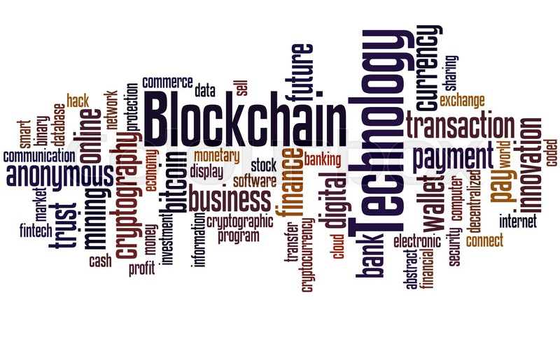
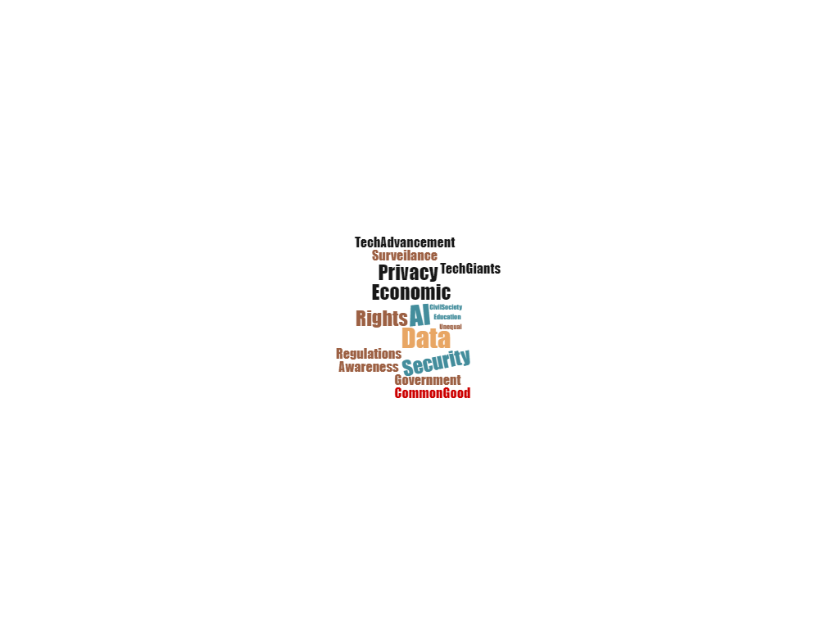
Impact of Digital on Civic Space : Four plausible futures to 2030
CIVIC SPACE COULD COLLAPSE
CIVIC SPACE COULD FLOURISH
CIVIC SPACE COULD BREAK APART
CIVIC SPACE COULD TRANSFORM ITSELF

Slide 12

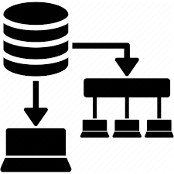


POLICY IMPLICATIONS FOR DEVELOPMENT CO-OPERATION
Collaborative &
democratic
Digital public & private accountability
High civic digital and data awareness and educated
Digital and data systems that are transparent & trustworthy
Notes:
A vast array of policy issues need to be considered in order to leverage the opportunities that digital transformation offers while mitigating adverse impacts on civic space. These range from issues related to strengthening legal and regulatory frameworks for civic space in partner countries that are adapted to the digital age and comply with international digital governance and human rights frameworks; tackling the digital divide between and within countries and promoting a digital space that is safe, free, open and inclusive, as well as strengthening co-operation for the international regulation of corporate digital governance.

Slide 13
POLICY IMPLICATIONS FOR DEVELOPMENT CO-OPERATION
A 15-point policy implications checklist
For the development co-operation community
To help avoid the 2030 collapse and fragmentation of civic space
in the face of digital transformation
Notes:
A 15-point policy implications checklist for the development co-operation community to help avoid the 2030 collapse and fragmentation of civic space in the face of digital transformation:
1. Lead a global conversation to protect civic space: The development co-operation community leads a global conversation to promote democratic rights and to protect civic space in partner countries in the digital era.
2. Tackle disinformation and misuse of platforms: The development co-operation community supports programmes and policies that tackle disinformation and the misuse of social media platforms in partner countries. It supports the implementation of policies that require social media companies to report the misuse or manipulation of their platforms. It supports policies that require social media companies to work closely with academics and civil society to identify malevolent content. It supports programmes and projects that invest in quality journalism and/or investigative journalism in partner countries.
3. Meet international standards for civic rights: The development co-operation community supports policies and programmes to limit abusive surveillance and safeguard against censorship and arbitrary shutdowns in partner countries. It supports policies and programmes that ensure that content-based restrictions in partner countries meet international standards in the area of civic rights.
4. Create mechanisms into the use of AI and algorithms: The development co-operation community supports the creation of mechanisms for transparency, oversight, and inclusion into the use of artificial intelligence and algorithms used in partner countries. It ensures that the use of these technologies does not violate any human rights principles or international conventions.
5. Design consultation mechanisms for public feedback on AI strategies: The development co-operation community supports the design of consultation mechanisms for public feedback into the design and implementation of AI strategies in partner countries.
6. Generate more resources domestically for CSOs: The development co-operation community helps local CSOs in partner countries generate more resources locally to reduce their vulnerability to repressions.
7. Address the opacity of digital-based repression: The development co-operation community helps ensure that digital-based repression and the use of surveillance and data collection to impose restrictions are no longer opaque or covert outside of the knowledge of the general public.
8. Implement cyber surveillance laws: The development co-operation community promotes clearly defined cyber surveillance regulations that address the procedures for governmental actors to obtain permission from an independent judiciary body.
9. Create cyber surveillance bodies and institutions: The development co-operation community supports the creation of institutions in partner countries where CSOs and individuals can safely denounce surveillance abuses as well as seek legal assistance.
10. Implement data rights and privacy laws: The development co-operation community supports the creation of data protection legal frameworks which take into account specific conditions for disclosure of personal data and data processing. It also supports regulations which give rights to individuals to decide what is accessed, stored and shared independently of public bodies and corporations.
11. Implement internet access and control laws: The development co-operation community supports legal frameworks that specify the rights of users to access and receive content over the internet as well as specify conditions under which internet service providers can control or price internet content and protocol.
12. Bridge the gender digital divide: The development co-operation community supports policies and training programmes that specifically focus on entrusting technological knowhow for civic participatory purposes to women.
13. Bridge the socioeconomic digital divide: The development co-operation community supports policies and training programmes that teach low-income and/or marginalised individuals how to voice their concerns and opinions on digital civic platforms.
14. Bridge the rural-urban digital divide: The development co-operation community supports policies that establish quality broadband Internet infrastructure in rural areas as well as training programmes that teach rural individuals the technological knowhow to use digital civic platforms so to reduce inequalities in digital access for civic participatory purposes.
15. Engage with all civil society actors: The development co-operation community develops policies to support and engage with the vast array of civil society actors, from professionalised, institutionalised CSOs to non-traditional, more fluid forms of civic activism such as large-scale social movements.
The points of this checklist draw inspiration and elements from the following sources: (i) Open Government Partnership’s Strengthening Democracy and Protecting Civic Rights in the Digital Era, (ii) Oxfam’s blog From Poverty to Power: Here’s what we know about closing civic space, (iii) the European Parliament’s A governance framework for algorithmic accountability and transparency report, (iv) the European Commission’s Tackling Online disinformation and (v) OECD’s Artificial Intelligence in Society report.

Slide 14

Development co-operation in 2025: what could change with the current global health and socioeconomic crises?

Slide 15


Development co-operation in 2025: what could change with the current global health and socioeconomic crises?
Scenario 1 devco digitalises
Scenario 2 devco power dynamics shift
Scenario 3 Locally-led devco culminates
Scenario 4 a new global architecture takes root
Notes:
DEV CO digitalizes
Digital tech-enabled innovative responses to the needs of local populations are favoured.
Bridging the gender digital divide is prioritised.
Addressing gender digital divide and racial bias in AI becomes a development co-operation priority.
The health crisis serves as fitness for the climate crisis.
Govtech ecosystems
Digital trade
Acceleration of the 4th Industrial revolution
Digital government
Public Private partnerships between devco donors and tech-based, data driven start-ups
Implications to consider : Policy coherence issues e.g. digital trade/ partnerships modalities/ policies and strategies to tackle gender divide
DEV Co power dynamics shift
China dominates the global development co-operation system. Accelerating the Digital Silk Road
The Sino-Russian normative partnership strengthens.
The Sino-Russian deliberate challenging of western norms and values within the multilateral system accelerates.
The Global South’s middle power leadership rises.
Private sector replaces the public sector in sustainable investing
Strategic implications to consider: balance the domination of China/ DAC narrative on development cooperation/ public or private support for sustainable development? Investing in social governance?
LOCALLY-LED DEVCO CULMINATES
Globalization makes way for the regionalization
Autonomous bioregions in food and energy emerge as the next logical cascade effect
Localization rises
State ownership rise
Locally led development rises
Production stays at home
Strategic implications: Support a globalization –regionalism shift? Facilitate the transition to autonomous bioregions in food and energy in partner countries? Or support measures to counteract “de-globalization” and weakening of global values chains? Prioritize Partnerships with CS actors?
A NEW DEVCO GLOBAL ARCHITECTURE TAKES ROOTS
The number of Global South voices amongst civil society that question the current global development narrative grows significantly.
The call for reparations grows louder.
The movement #ShiftThePower gains traction.
Philanthropy actively begins to support social movements.
The concept of humanitarianism gains traction.
The concept of Global Public Investment (GPI) gains traction.
Countries that deploy advanced AI surveillance tools to monitor, track and surveil citizens significantly increase.
Policy inplications: Global Public Investment or 2030 Agenda?

Slide 16
SCENARIO 2
DEVCO POWER
DYNAMICS
SHIFT
SCENARIO 1
DEVCO DIGITALISES
Digital tech-enabled innovative responses to the needs of local populations are favoured.
Bridging the gender digital divide is prioritised.
Addressing gender and racial bias in AI becomes a development co-operation priority.
The health crisis serves as fitness for the climate crisis.
Risk-informed development co-operation is enshrined
China dominates the global development co-operation system.
The Sino-Russian normative partnership strengthens.
The Sino-Russian deliberate challenging of western norms and values within the multilateral system accelerates.
The Global South’s middle power leadership rises.
The African middle class partially collapses.
Poverty skyrockets due to suboptimal policies.
The polarisation of Latin American societies accelerate.
The private sector replaces the public sector in sustainable investing.
8

Slide 17
SCENARIO 3
LOCALLY-LED DEVCO
CULMINATES
SCENARIO 4
A NEW DEVCO GLOBAL
ARCHITECTURE
TAKES ROOTS
Global trade’s nosedive accelerates.
Globalisation makes way for regionalisation.
The US-China trade war accelerates this globalisation-regionalisation shift.
Autonomous bioregions in food and energy emerge as the next logical cascade effect of regionalisation.
Localisation rises.
Locally-led development rises in cascade.
CSOs from the Global South rise in sync.
The Great Bargain gains pre-eminence.
State ownership also rises.
Production stays at home.
Remittances dwindle.
Blockchain partially helps offset the drop in remittances by drastically reducing the cost of cross-border transactions.
India becomes one of the world’s blockchain leaders.
The number of Global South voices amongst civil society that question the current global development narrative grows significantly.
The call for reparations grows louder.
The movement #ShiftThePower gains traction.
Philanthropy actively begins to support social movements.
The concept of humanitarianism gains traction.
The concept of Global Public Investment (GPI) gains traction.
Countries that deploy advanced AI surveillance tools to monitor, track and surveil citizens significantly increase.
9

Slide 18
In case you have missed them….
  Current Existential and Systemic Risks
Climate change, environmental challenges and biodiversity threats, climate finance, green transition
Non proliferation, higher risks for Nuclear War
See UN Global Assessment Report on Disaster Risk Reduction
Drivers of change
Structural economic changes, accelerated by Covid 19
Geopoliticall tensions, global hegemony and new global order, new global and
regional power dynamics
Continued rising inequalities and increased extreme poverty, deglobalization, rising
populist forces, polarization
Population growth vs. aging population, consumption and substantial changes in the job market
Slow pace on transition to a more sustainable global model, how to govern global institutions
Short-term political cycles/ populism

Slide 19
So what will the Future of Development be?
Continuation of the current trend of rising ODA?
Changes to the whole architecture of the development system?
  Disruptive changes (things we know that we don not know)
  The rise of the south, it is unfolding already
  The decline of the North
  Powerful new actors from civil society and private sector
  Pressures from Covid and Ukraine (economic downturn)
  Major changes in the composition of development finance?

Slide 20


Official Development Assistance
Total ODA in billion USD
Share od ODA %
Source: OECD

Slide 21
Official Development Assistance
As share of Global GDP and Trade
Source: OECD , UN and the World bank

Slide 22
Official Development Assistance
Index 1990 = 100
Source: OECD , UN and the World bank

Slide 23
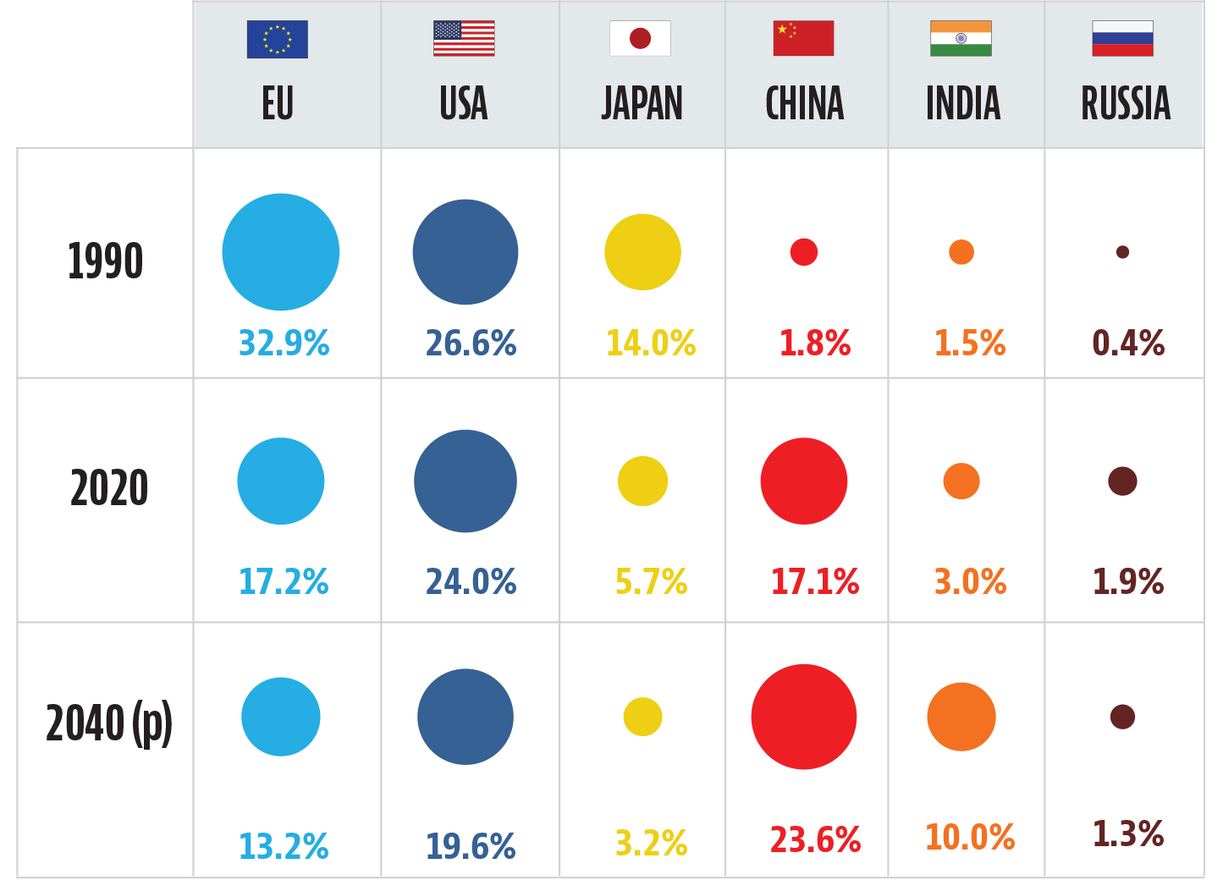
Major Economic Shifts – World has changed dramatically
Share of Global GDP
Source: OECD , UN and the World bank

Slide 24
Future Development actors?
Largest companies in the World
 | Company | Market Value (billion $US) | Countries | GDP (billion $US current)
1 | Apple | 2500 | India | 3100
2 | Microsoft | 2000 | Canada | 2000
3 | Alphapet | 1500 | Russia | 1700
4 | AMAZON | 1450 | Australia | 1600
5 | Tesla | 1000 | Nigeria + Egypt + Ethiopia | 980

Slide 25
Cross-scenario strategic questions to consider
Do you have the vision, strategy and tools available to tackle the challenges, as well as to seize the opportunities described in this plausible future?
Are your development co-operation vision, strategy and tools to engage with the multilateral system fit for purpose in this plausible future?
Are your financing for development strategy and tools fit to tackle the challenges as well as to seize the opportunities described in this plausible future?

Slide 26
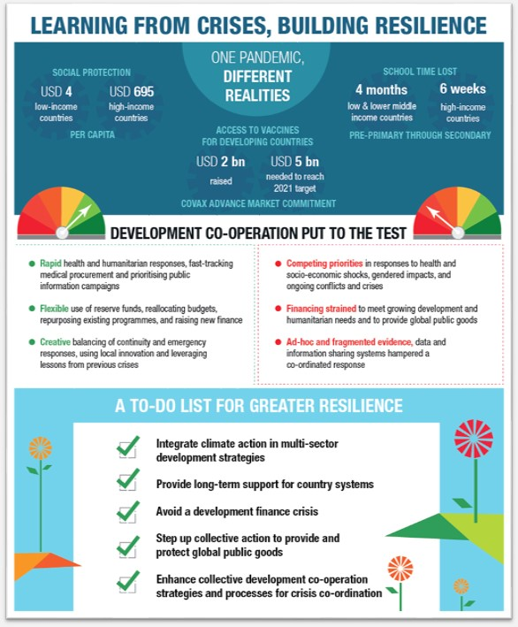

Slide 27
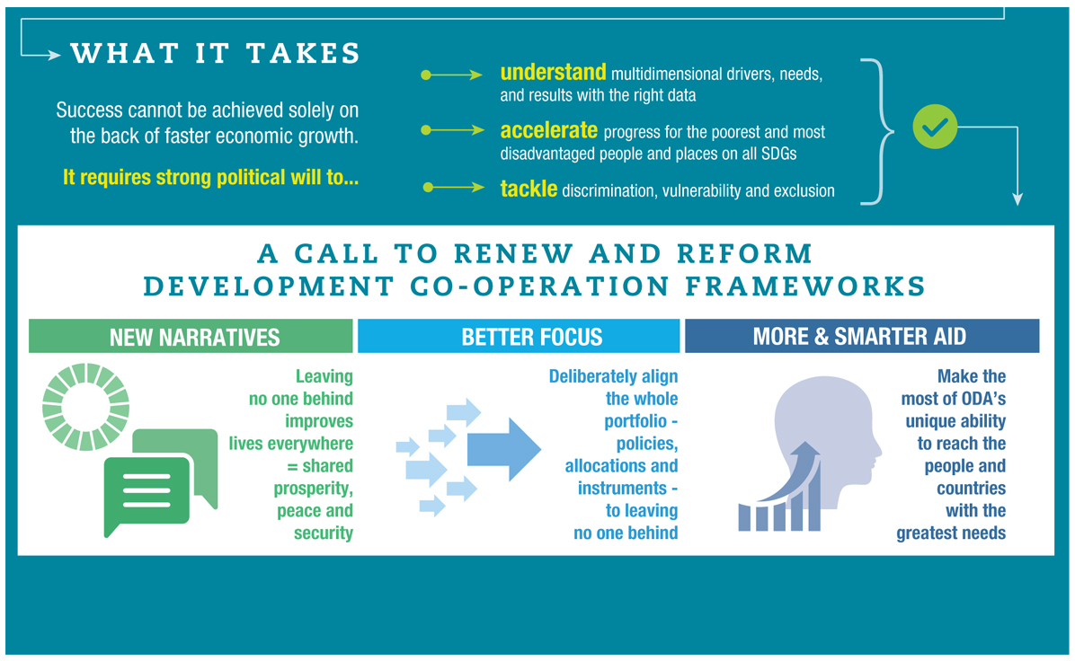

Slide 28

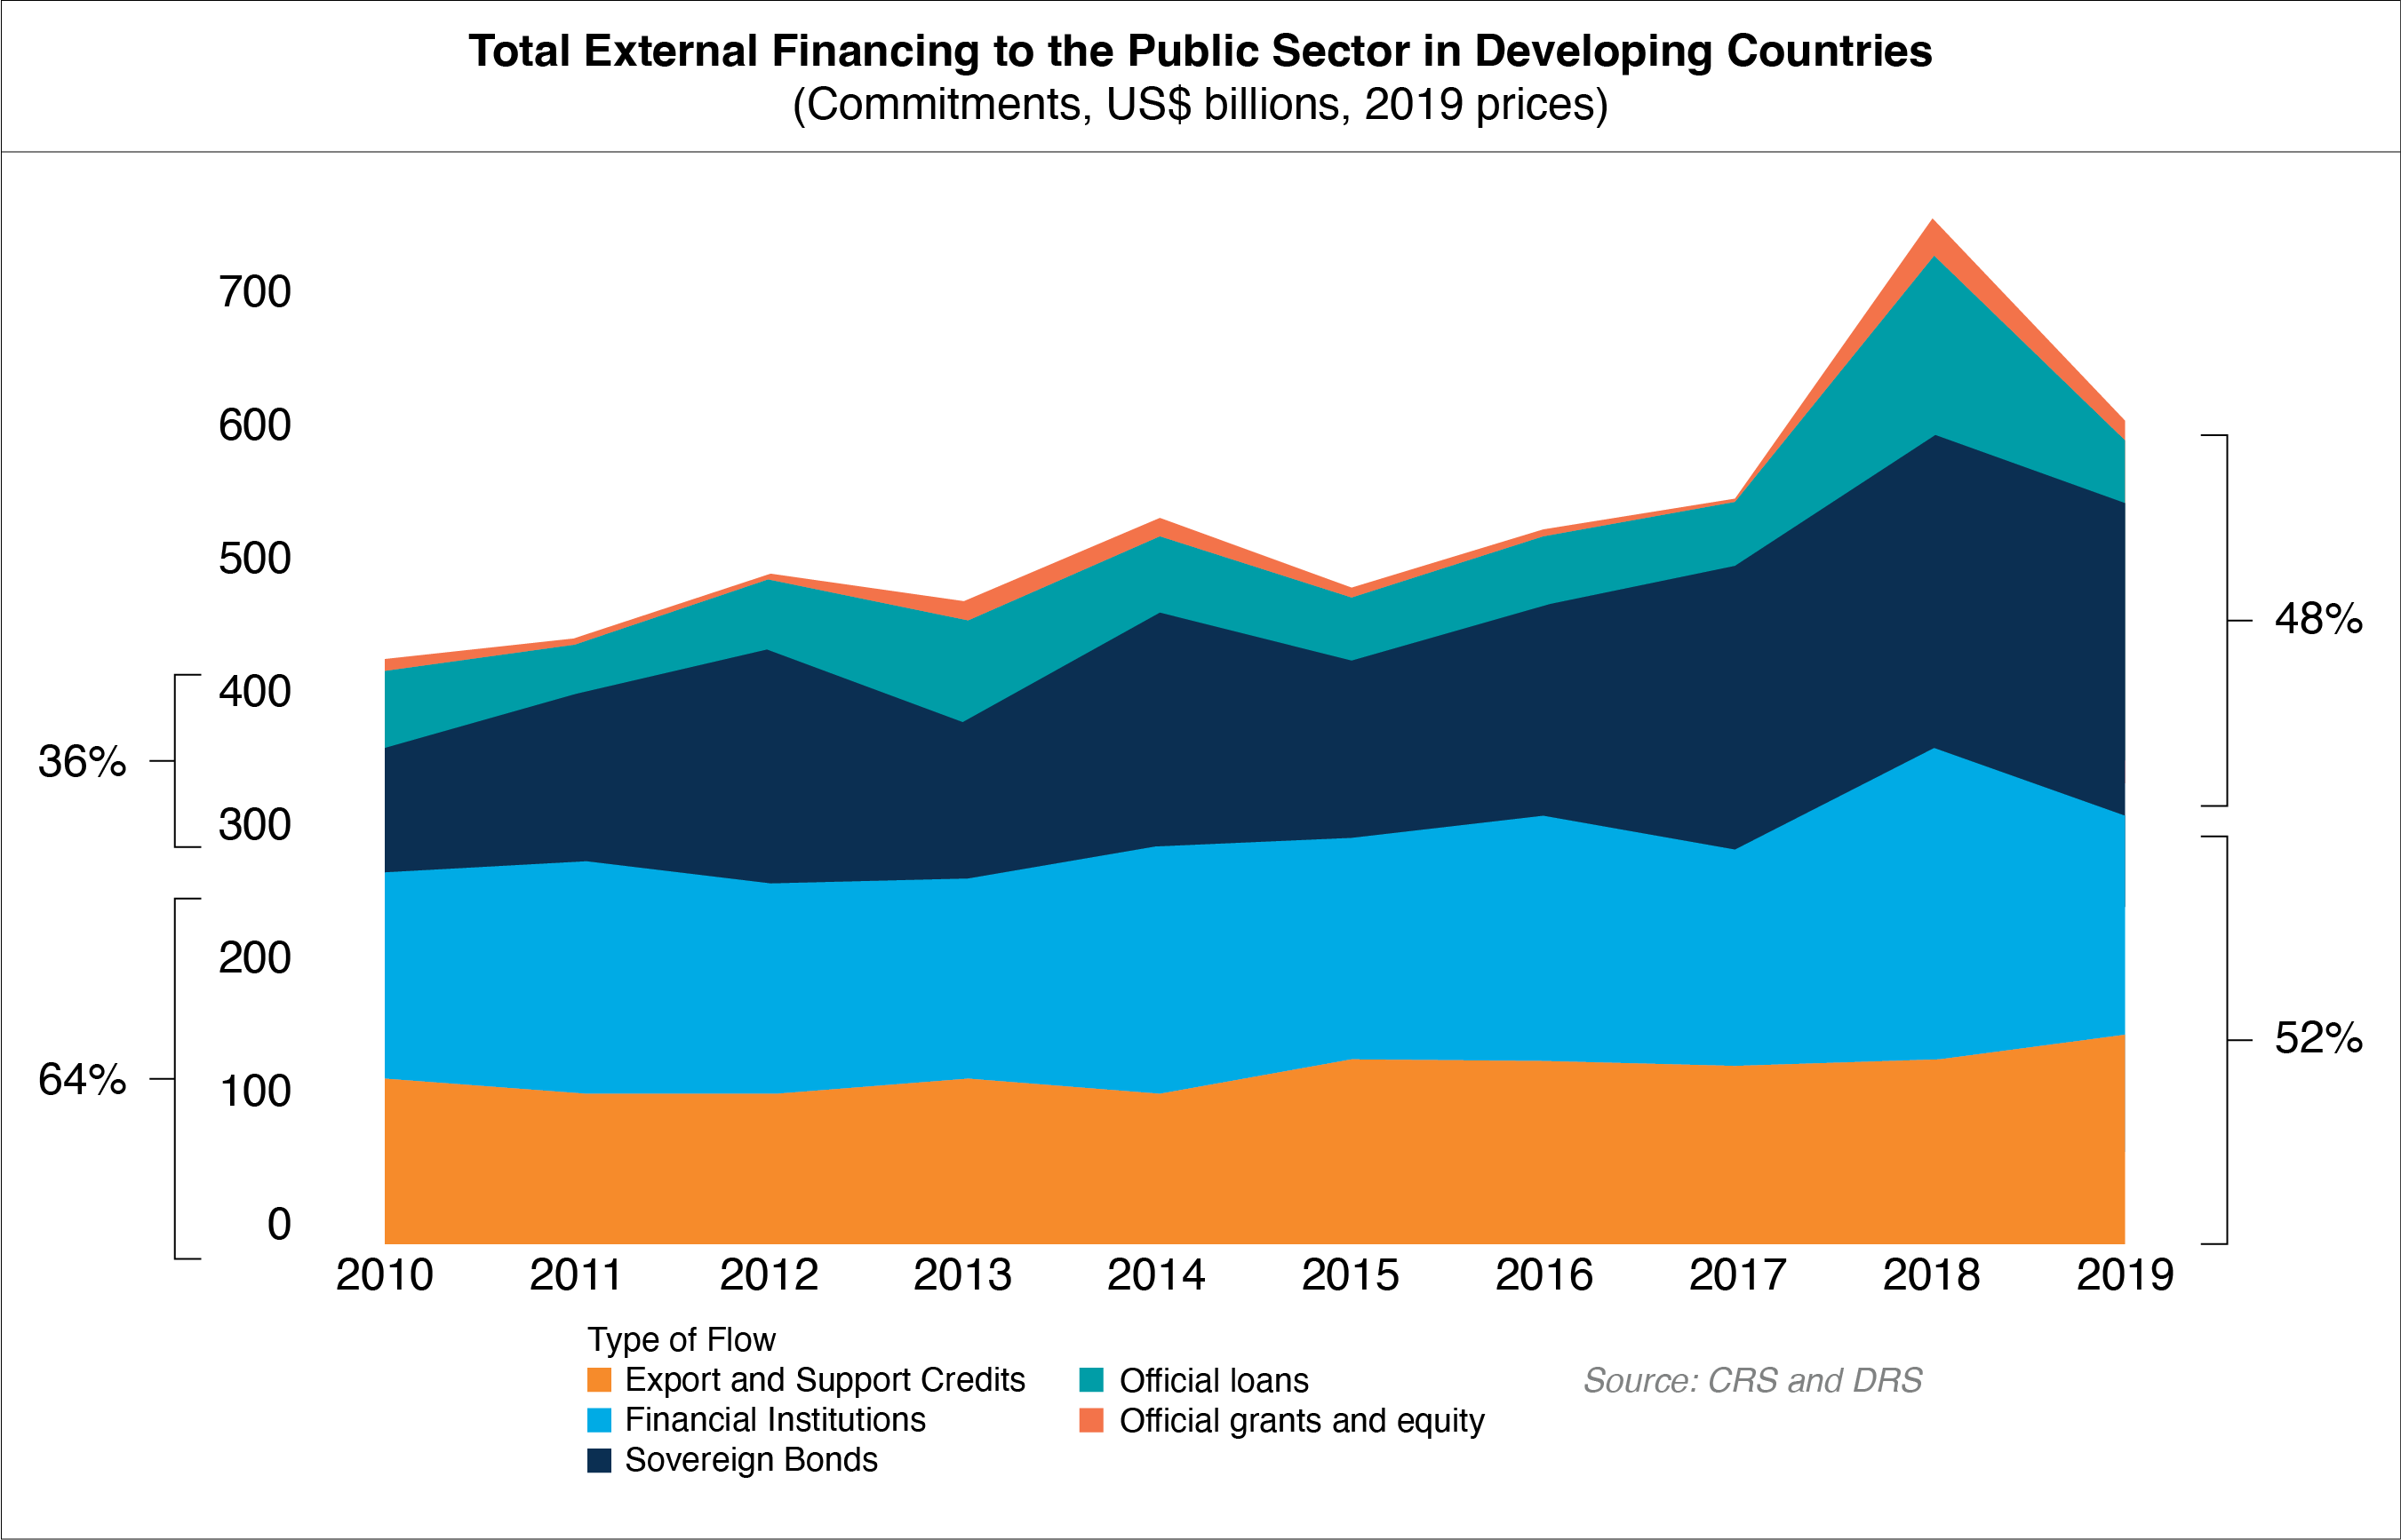
1. Financial flows to developing countries have grown steadily over the last decade, largely thanks to private sector finance

Slide 29

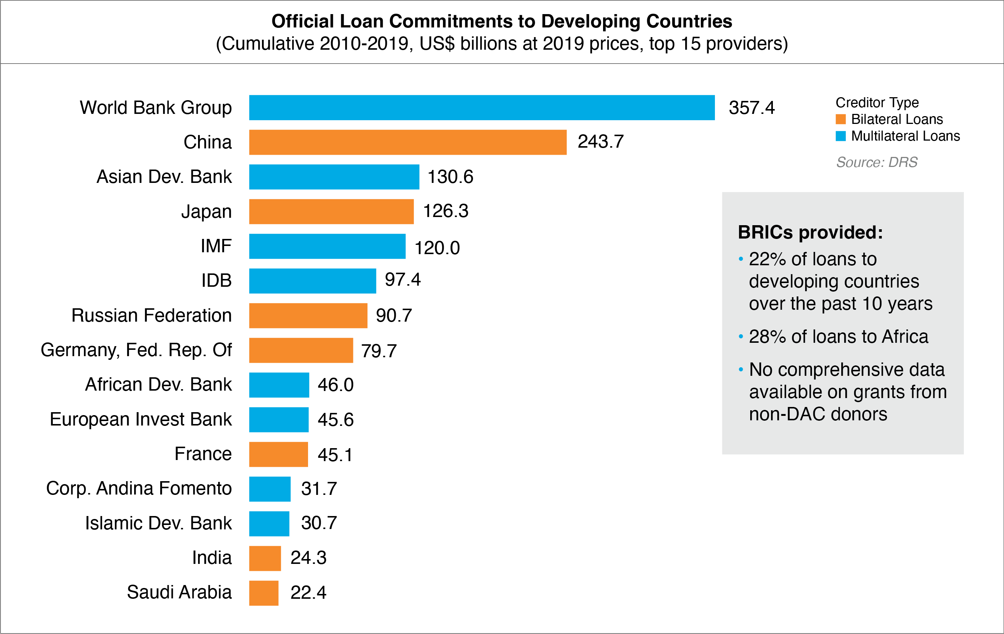
2. Among public lenders, BRIC countries provided significant volume of loan financing

Slide 30
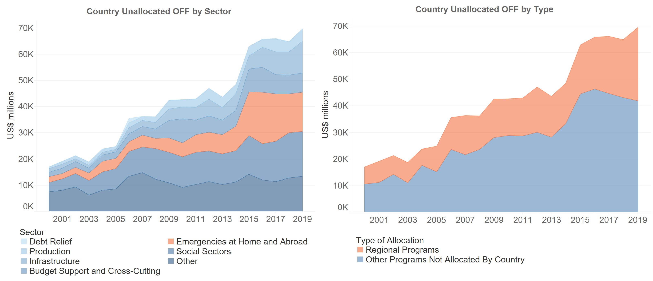
3. The volume of resources not assigned to specific countries almost quadrupled since 2000, now constituting more than a fifth of OFF
Distribution of Official Financial Flows (OFF) Unallocated to Specific Recipient Countries
(Commitments, US$ millions, 2019 prices)

Slide 31
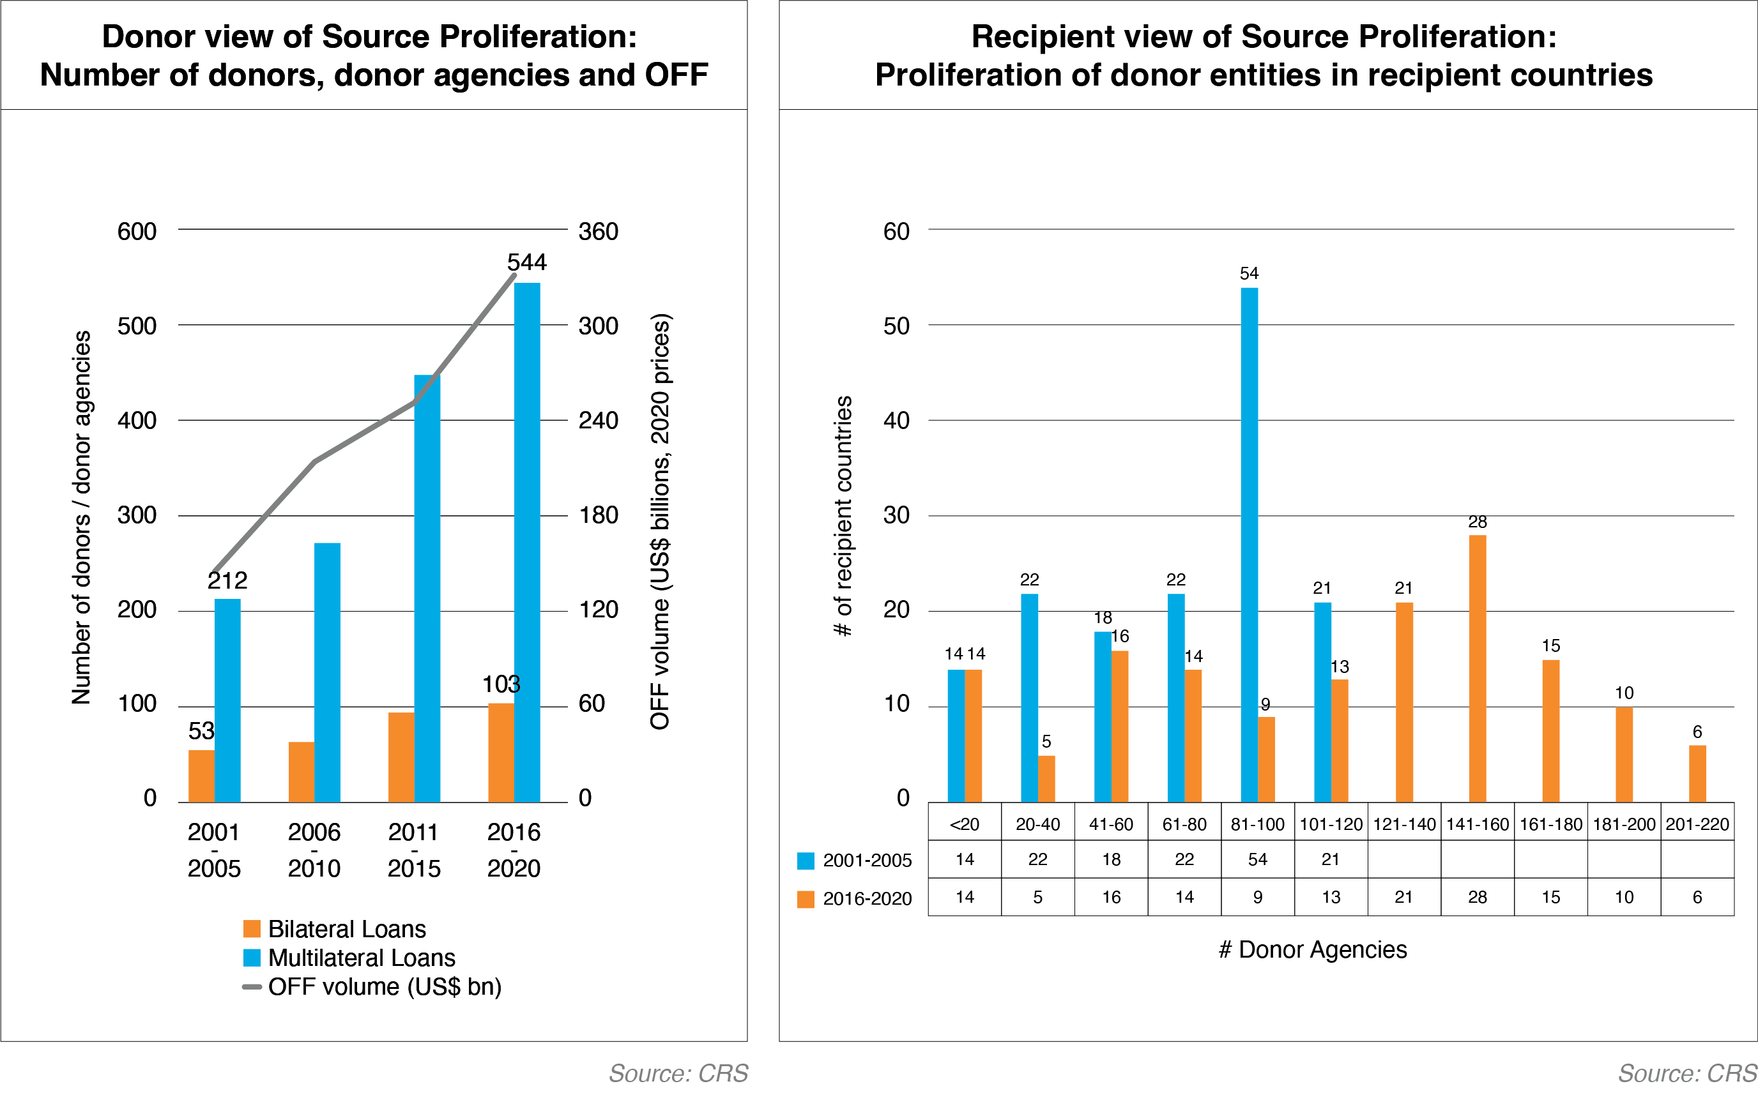
4. The increase in Official Financial Flows (OFF) over the last 20 years was accompanied by a rapid proliferation of donor countries/agencies globally at the source and the recipient level

Slide 32
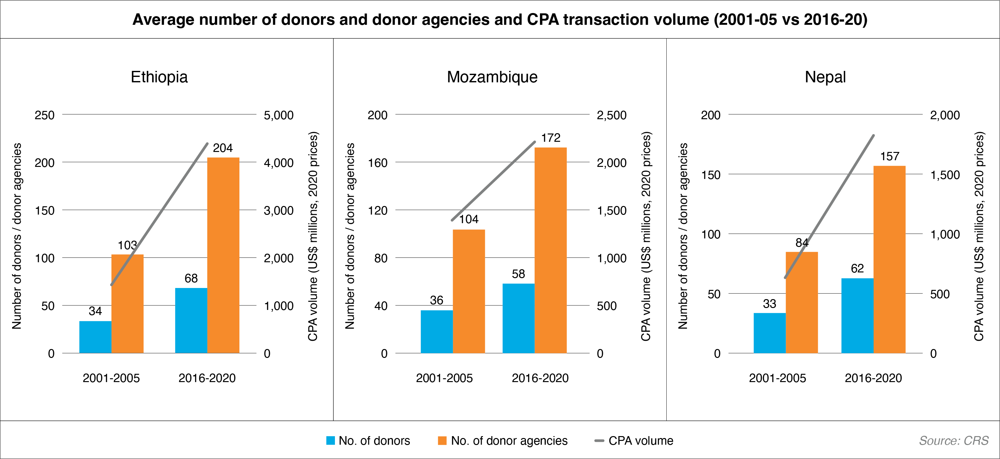
5. Ethiopia, Mozambique, and Nepal all had to engage with >150 agencies in 2016-20.

Slide 33
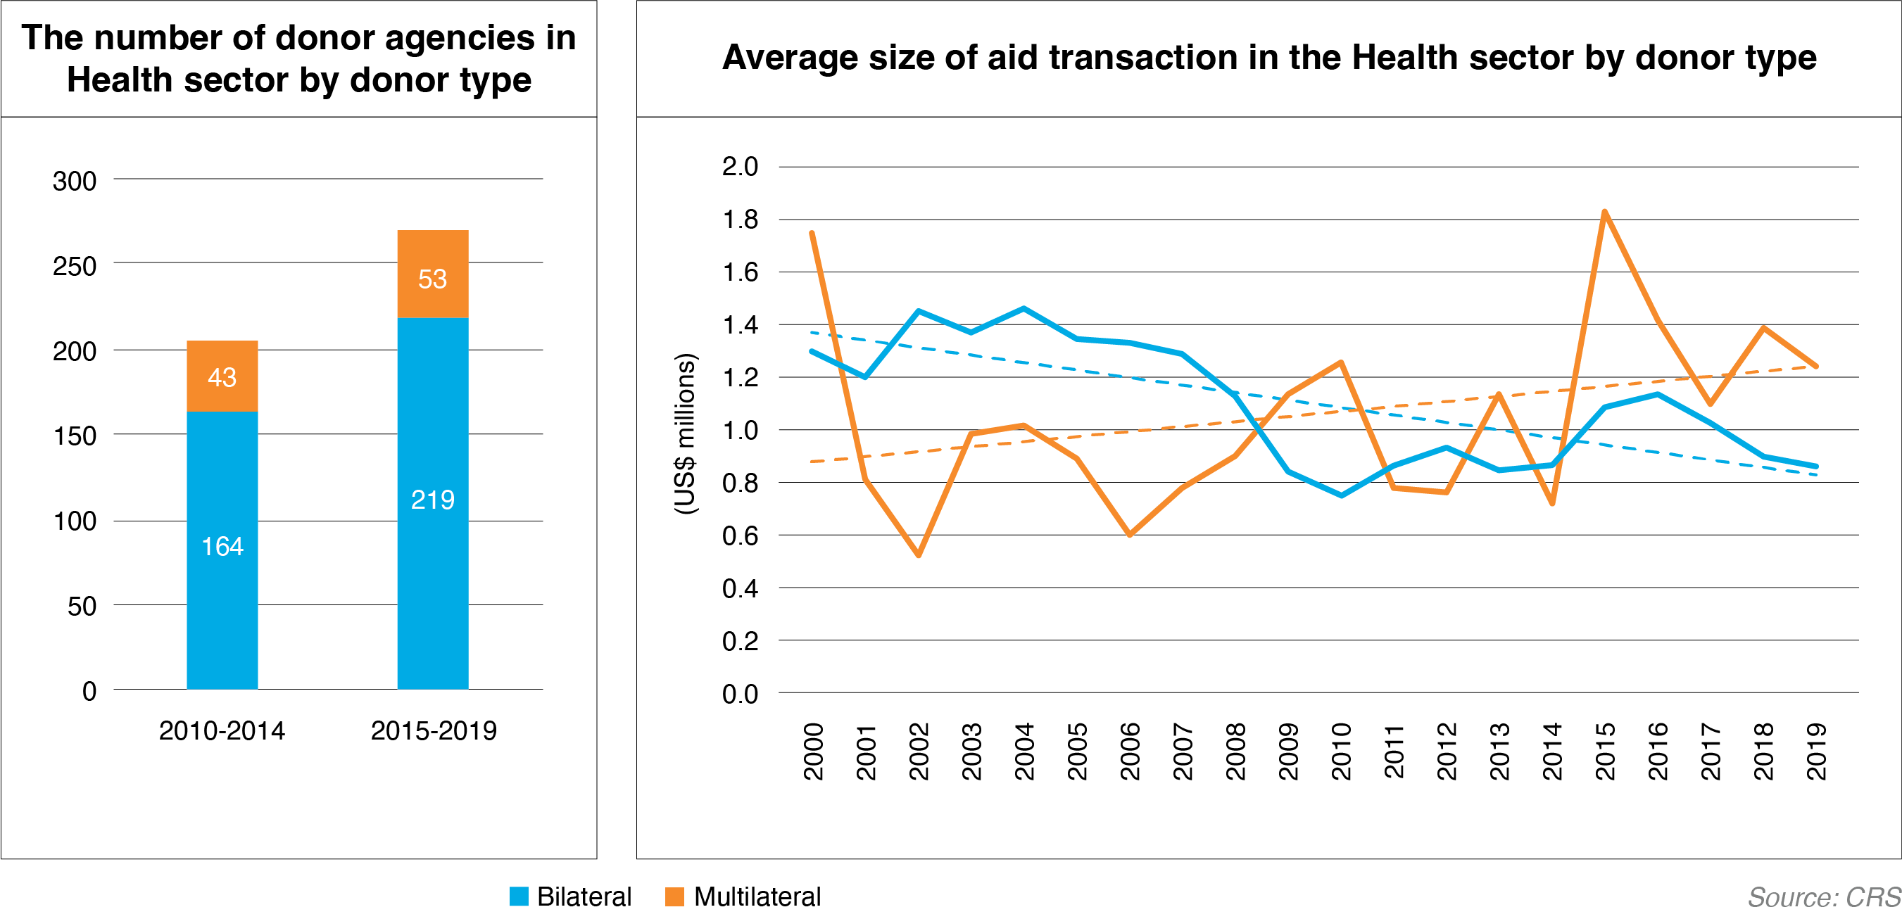
6. In the Health sector, for example, the number of bilateral agencies increased much more vis a vis the number of multilaterals while the average bilateral commitment size decreased in comparison with multilaterals

Slide 34
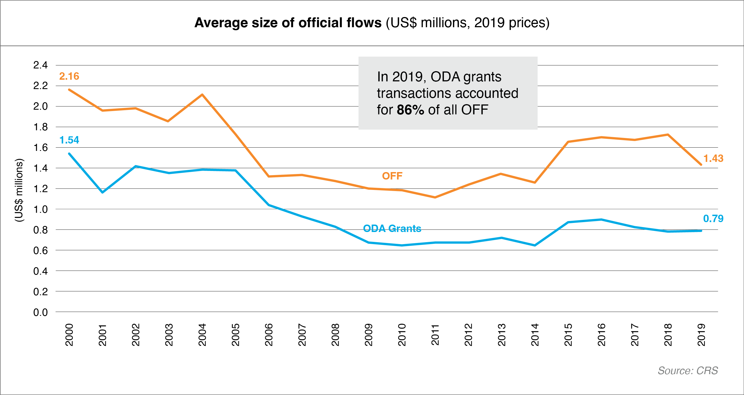
7. Development activities continue to be highly fragmented resulting in an overall decline in the average size of OFF by about one third, and of ODA grants by one half over the last 20 years

Slide 35
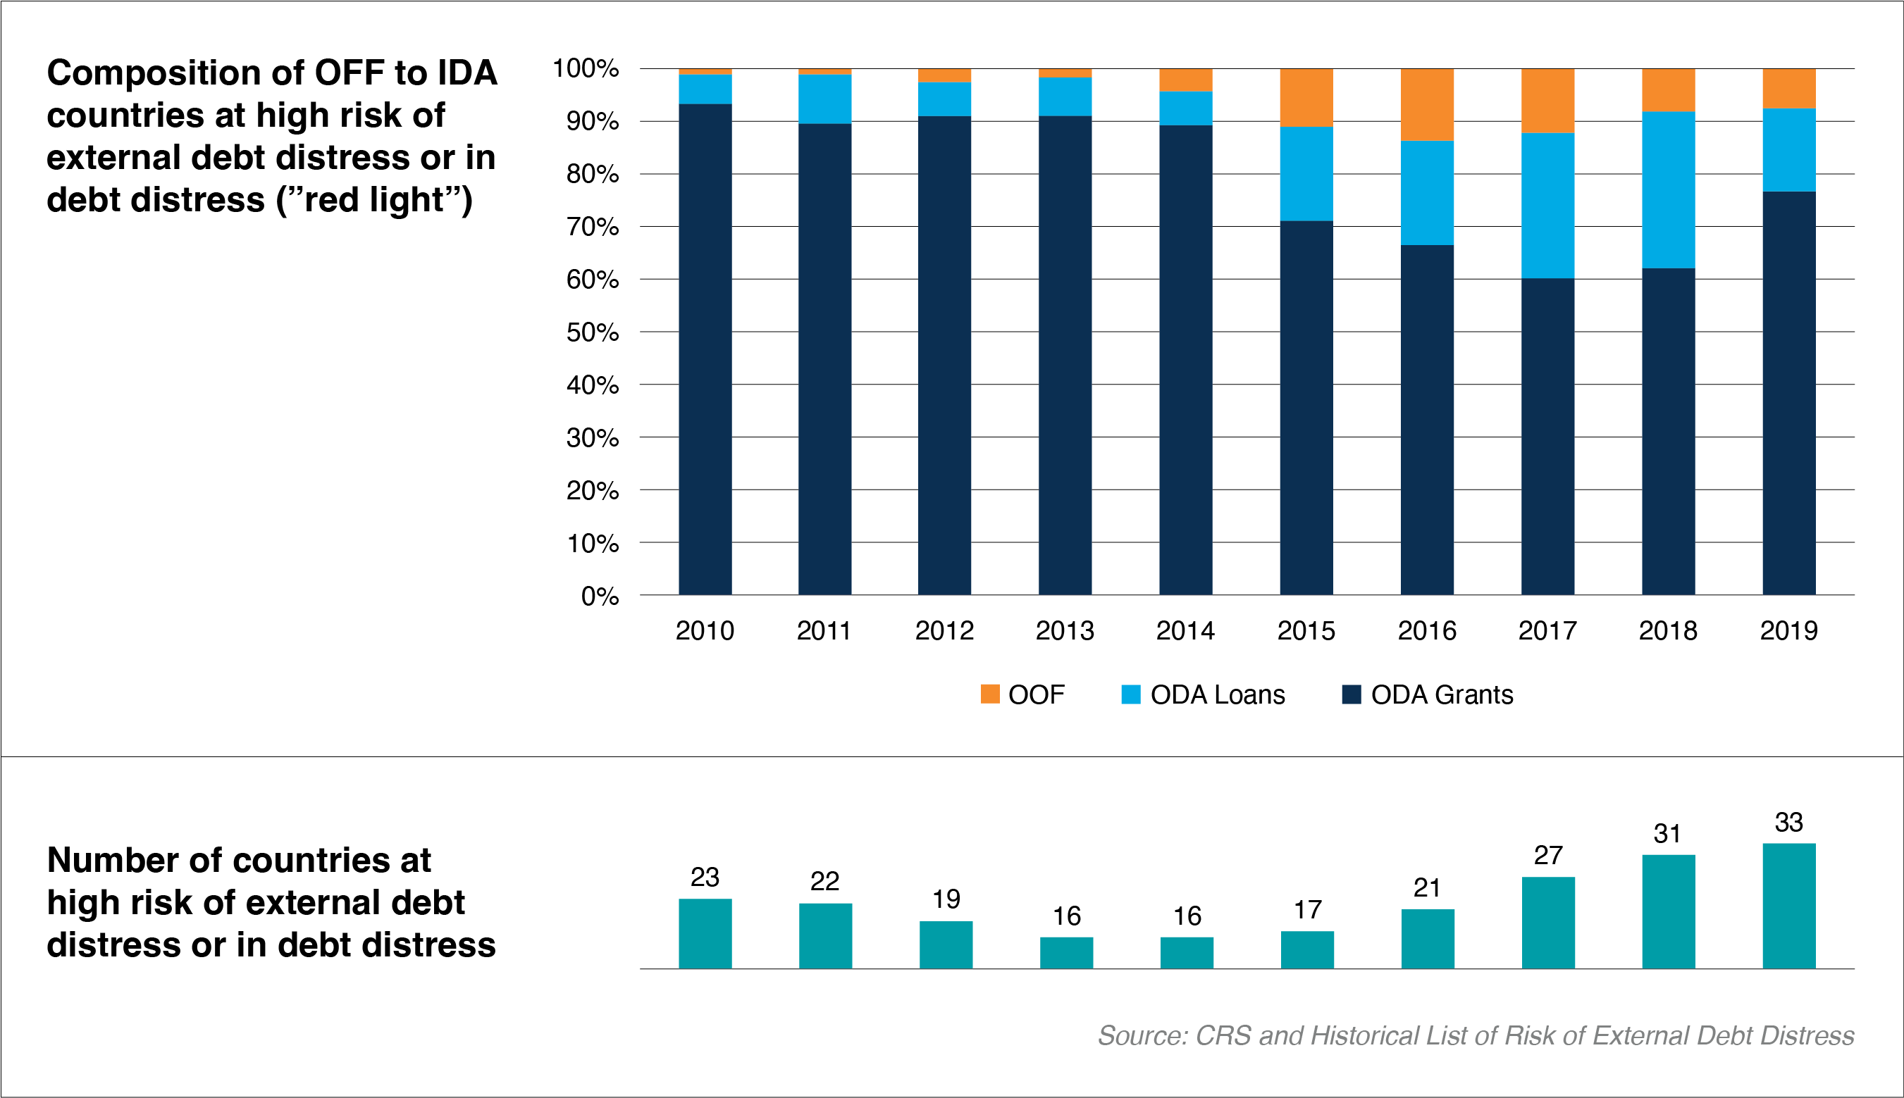
8. Concessionality to countries with debt vulnerabilities decreased in recent years, despite a rebound in 2019

Slide 36
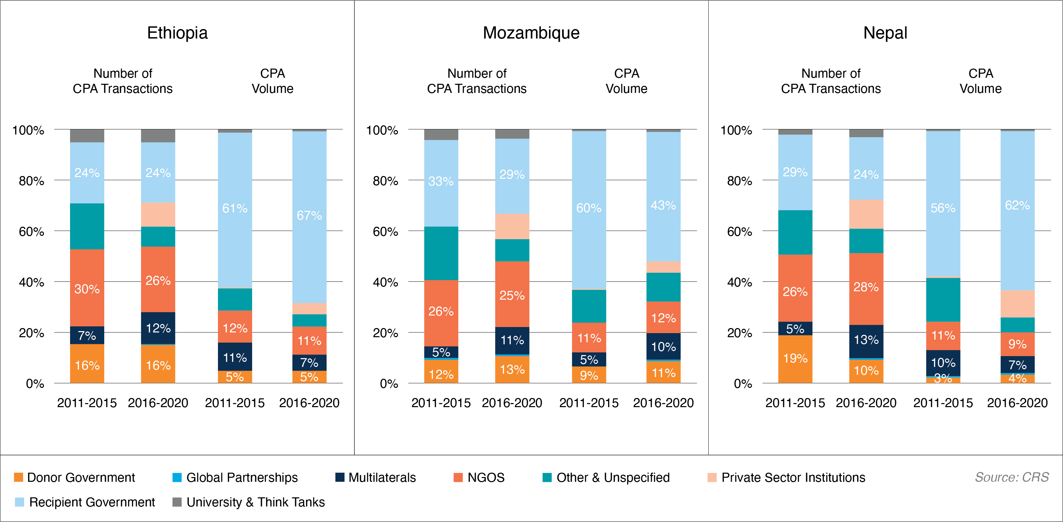
9. While country ownership of aid has improved in Ethiopia and Nepal, Mozambique government’s share in implementation has decreased

Slide 37
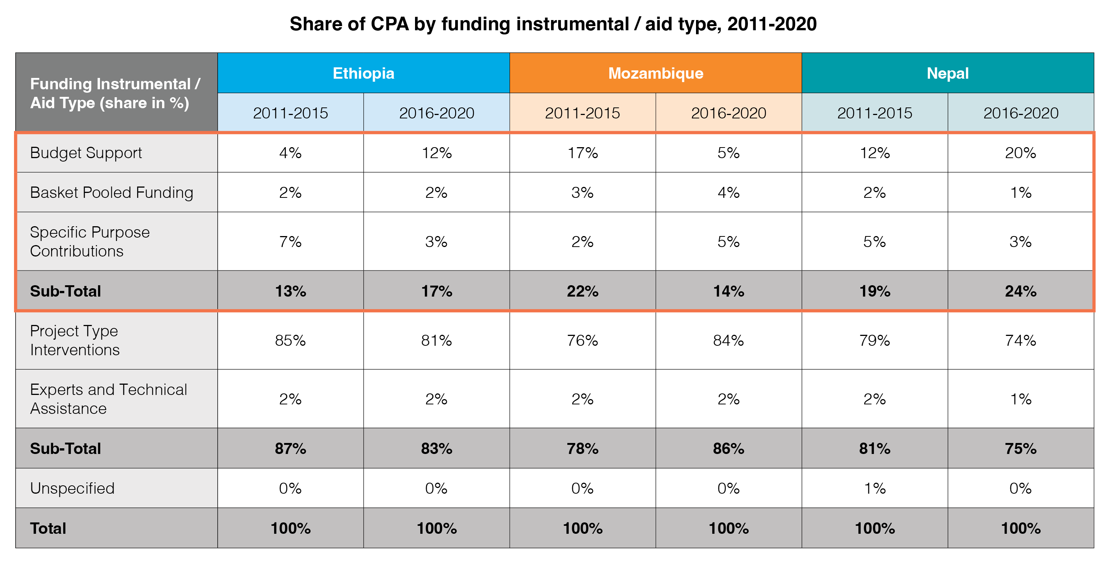
10. For funding provided to recipient governments, pooled funding is a recognized solution to reduce the impact of aid fragmentation, but its uptake has been low (< one fourth) in all three case studies

Slide 38



Conclusion
Only about 50% of the OFF goes through the countries’ budgets while 3 out of 4 projects funded by OFF are implemented by non-government agencies. Seventeen years after the Paris Declaration, it is hard to say that the countries are in the driver’s seat..
The increase in OFF was accompanied by significantly increased proliferation in donors and donor funding entities during the last two decades.
The increasingly more complex aid architecture makes development more challenging for poor countries, which are struggling to deal with the overlapping crises.
The World Bank has began to explore the impact of fragmentation and proliferation on aid effectiveness at the country level. In addition to Ethiopia, Mozambique, and Nepal, the Bank is considering many other IDA/IBRD countries in Africa, South Asia, MENA and East Asia regions.
It is imperative for the global aid community to work together to reverse these trends.
The collaboration needs to be far more inclusive than before and include non-traditional donors.
38

Slide 39
“Não vejam em mim um santo, mas um pecador que continuou a tentar.” Nelson Mandela

